Slide 1
Organization, Navigation, and Visualization of FaceBase Datasets
Rob Schuler
2020 FaceBase Users Bootcamp
November 18, 2020

Slide 2
Outline
How datasets are structured in FaceBase
Layout of a typical dataset display page
Citing FaceBase Data
Demo 1: an RNA-seq dataset
Visualization Example: Genome Browser
Demo 2: an imaging dataset
Visualization Example: Orthoslice Viewer

Slide 3
How Data Are Organized on FaceBase
An overall “schematic” to give you a map for how data and metadata are organized and how to navigate between elements of a dataset.

Slide 4
How Data Are Organized on FaceBase
Projects: individual labs or collaborations conducting hypothesis-driven research(*) that produce and submit data to FaceBase.
(* or dedicated to generating data)

Slide 5
How Data Are Organized on FaceBase
Dataset: a collection of metadata(*) and data files. Intended to represent a cohesive unit of output from a project. It may correspond to a set of publishable results.
(* “data that describes other data”)

Slide 6
How Data Are Organized on FaceBase
Protocol: description of the methods and materials used to (re)produce the results found in the dataset.
Has varied widely over the 3 phases of FaceBase.
We are currently revising guidelines based on emerging best practices.

Slide 7
How Data Are Organized on FaceBase
Experiment: an activity or procedure carried out within an overall investigation, such as a particular RNA-sequencing assay or imaging assay.

Slide 8
How Data Are Organized on FaceBase
Biosample and Replicate: the biological specimens, subjects or other material used in the experiments. Typically, organized in groups of control and mutant replicates.

Slide 9
How Data Are Organized on FaceBase
Data: generated or derived results stored in files and associated with a specific “replicate” (and therefore experiment and biosample).
Several categories: sequencing, processed, tracks, images, surface models, micro array)

Slide 10
Overview of Dataset Display
Summary
Visualization
Genome Browser
Surface Models
Orthoslice Views
Images
Experiments & Biosamples
Data Files
Sequencing, Processed, Imaging, Array, Supplementary, other…

Slide 11
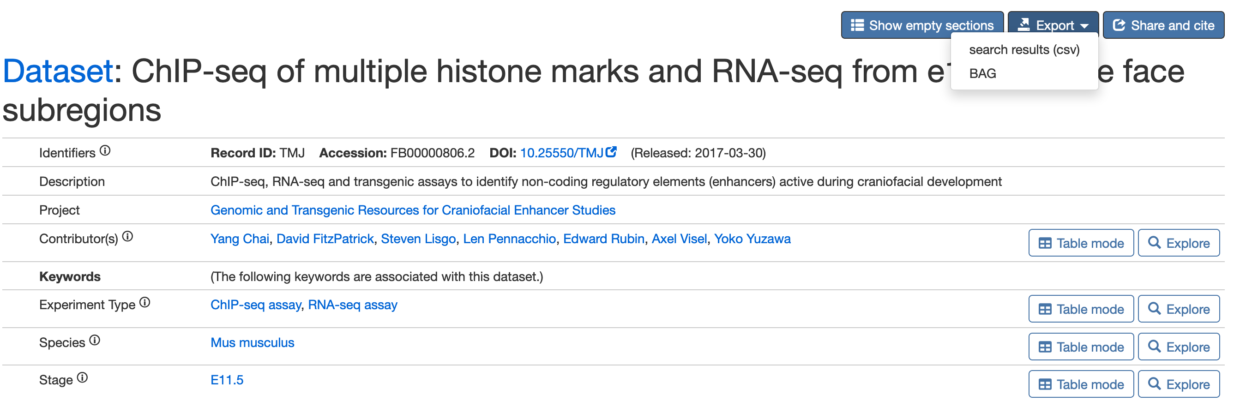
Summary of the Dataset Contents

Slide 12
Summary of the Dataset Contents
Persistent Identifiers (e.g., DOI)

Slide 13
Summary of the Dataset Contents
Persistent Identifiers (e.g., DOI)
Attribution of contributors

Slide 14
Summary of the Dataset Contents
Persistent Identifiers (e.g., DOI)
Attribution of contributors
Keywords from standardized terminology

Slide 15
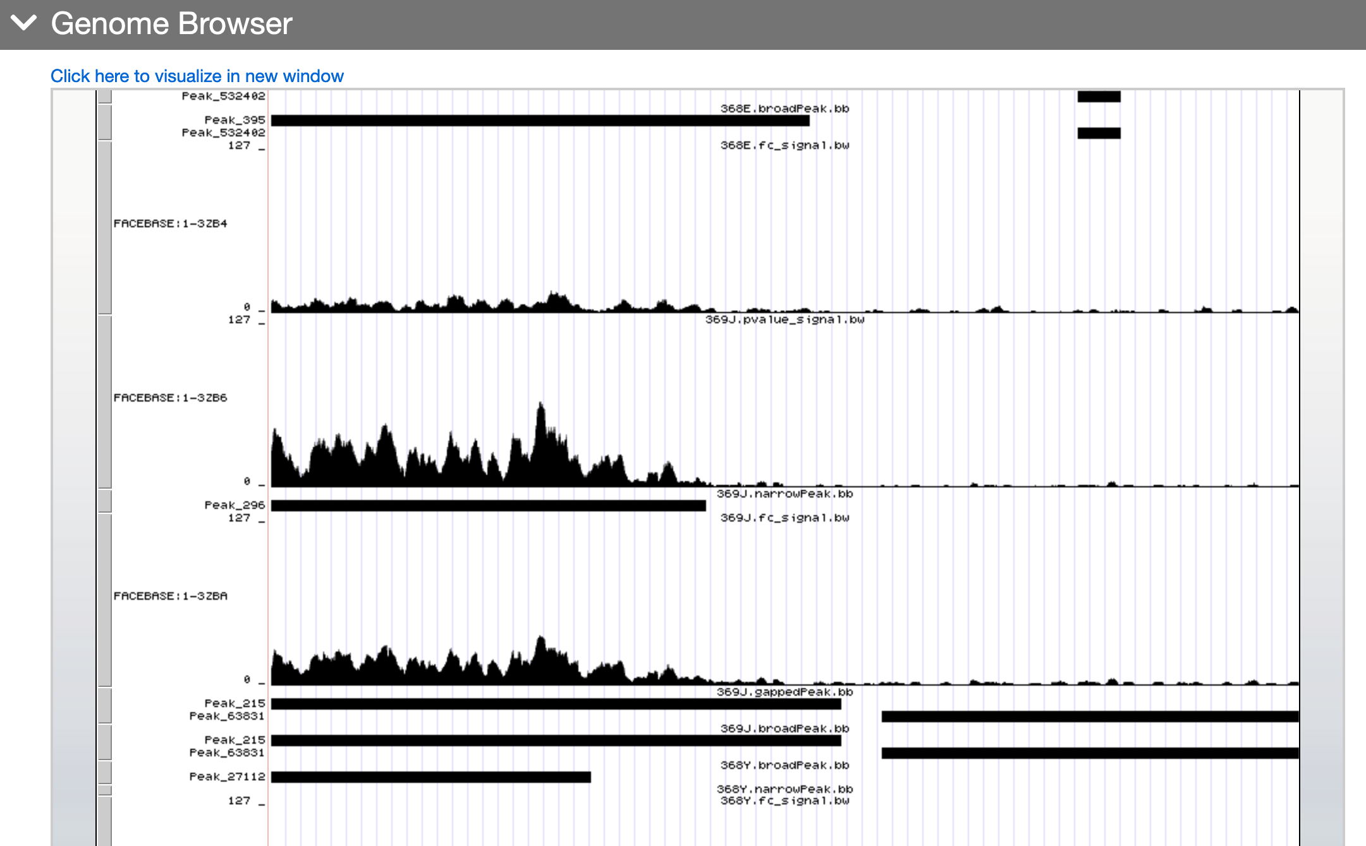
Embedded Visualization

Slide 16
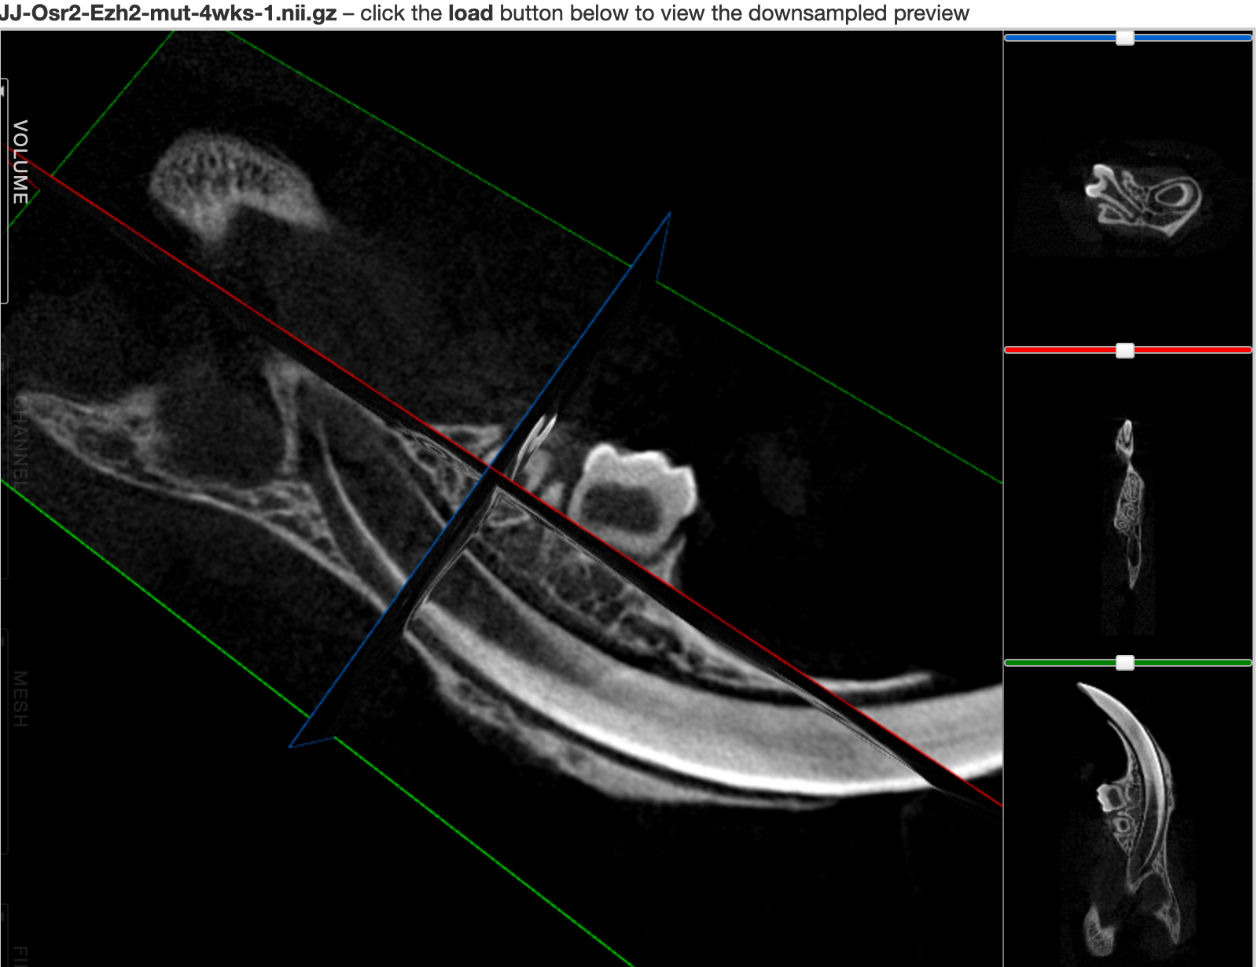
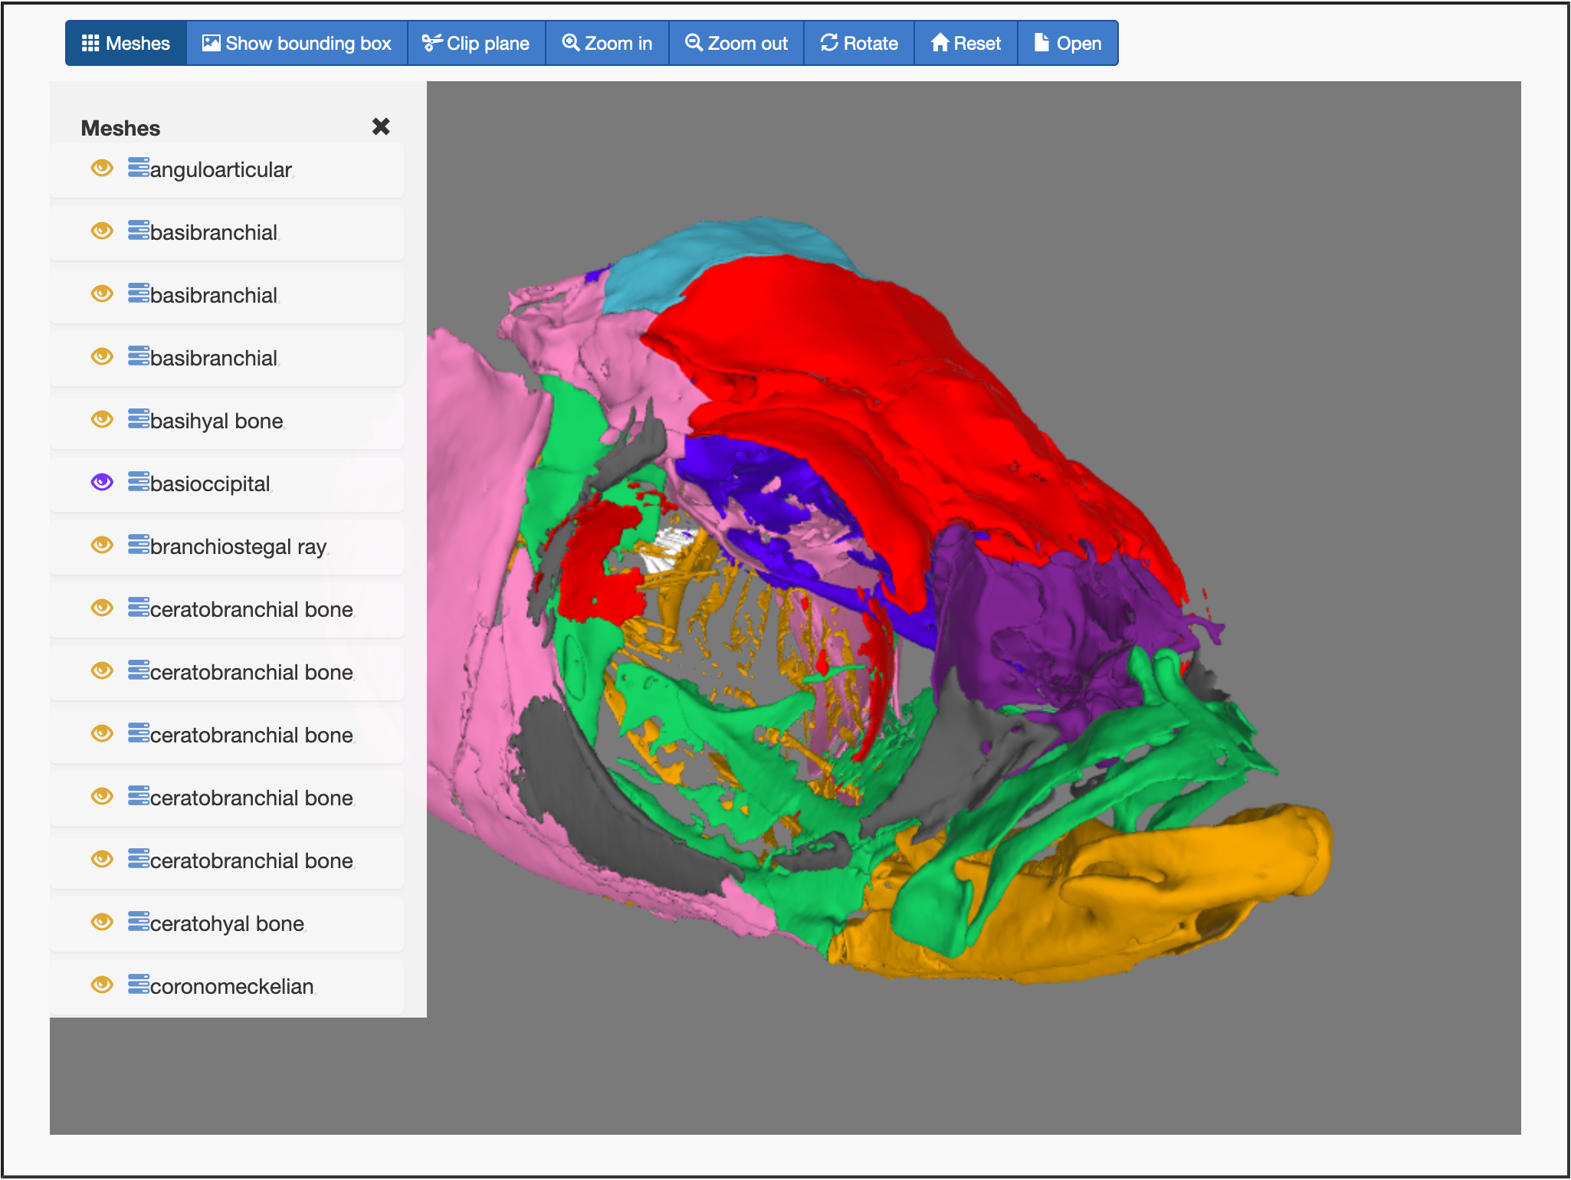
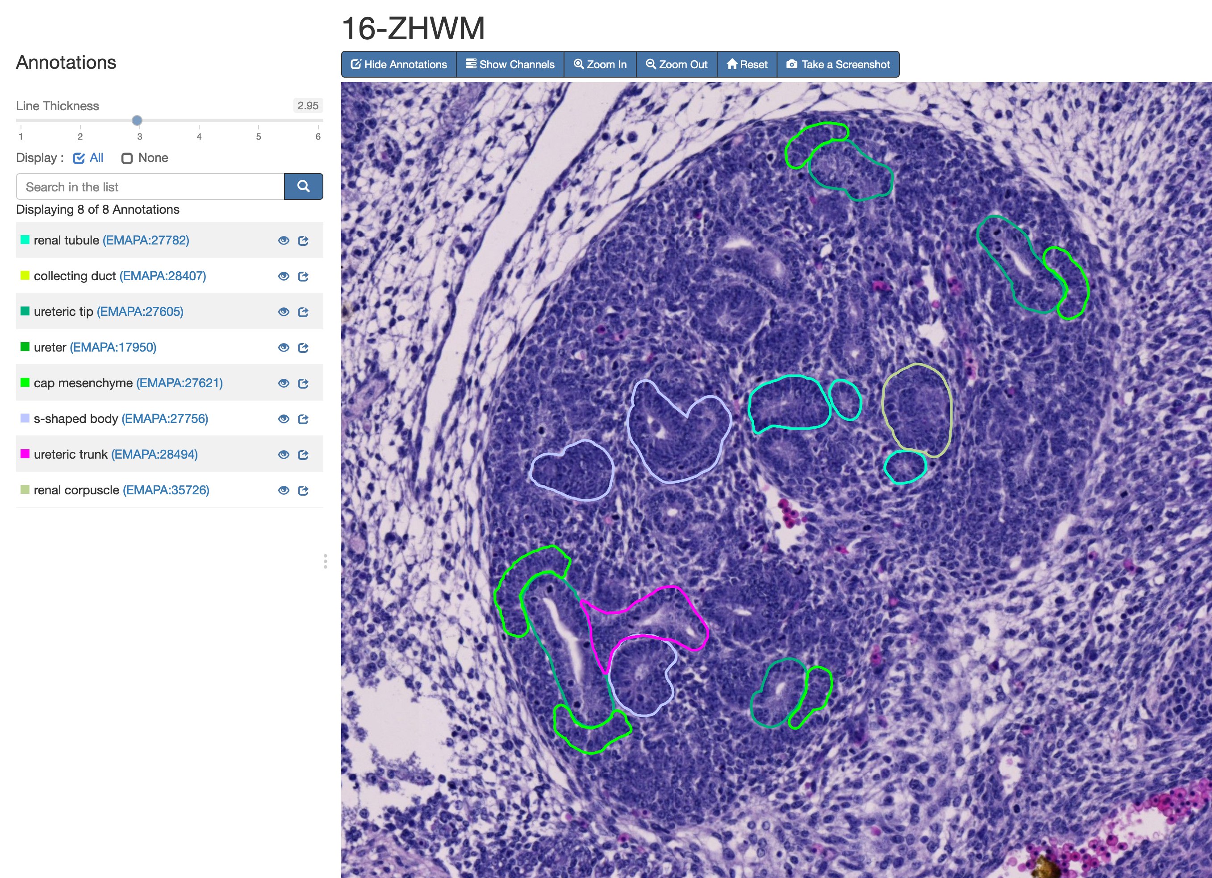
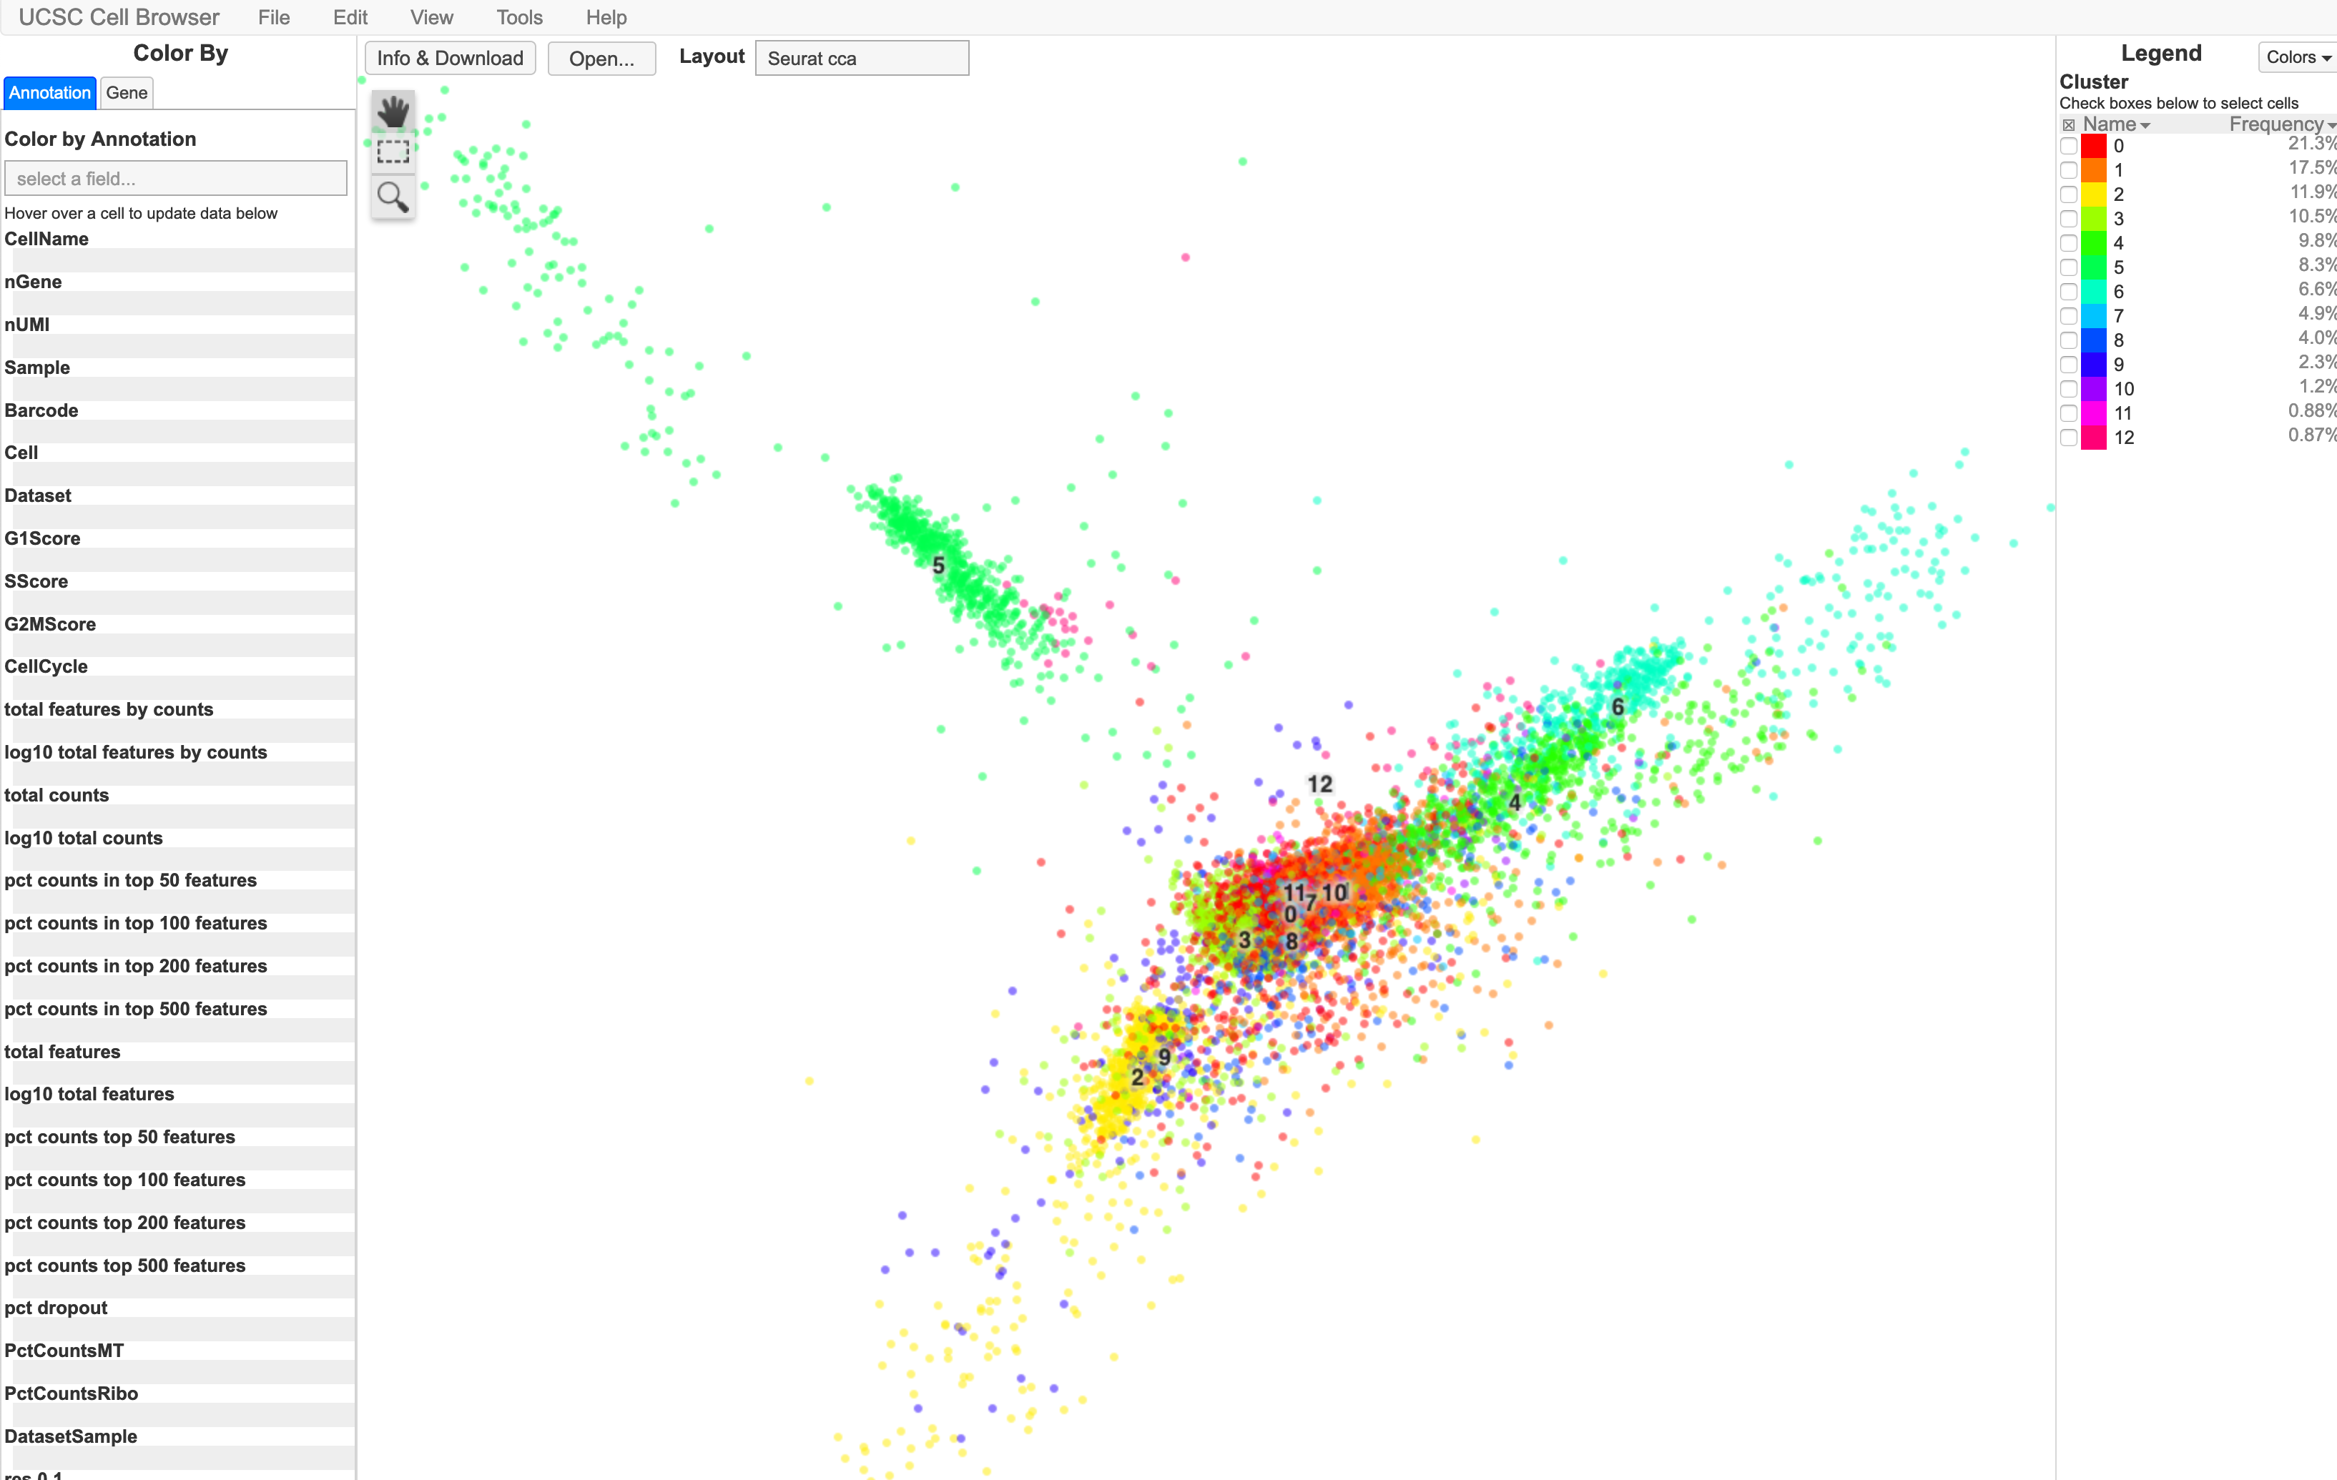
Embedded Visualization
Orthogonal Slice
Viewer
Surface Models
High-resolution Microscopy Images with Annotations
Single Cell Browser through Integration with UCSC

Slide 17
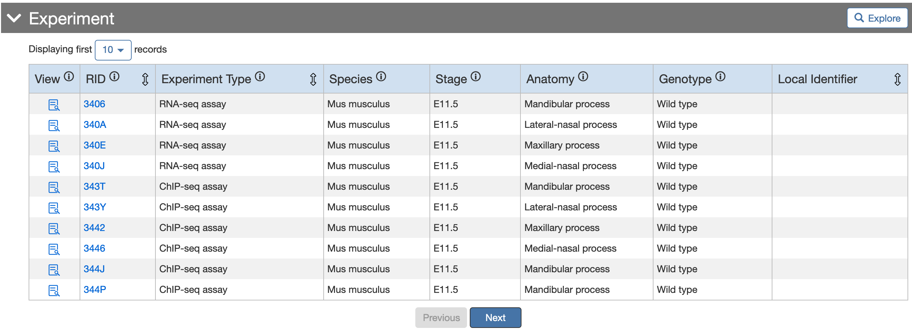
Details on Experiments, Biosamples, etc.
Further drill-down to related biosamples, files, and other related data.

Slide 18
Export (i.e., Download) Dataset

Slide 19
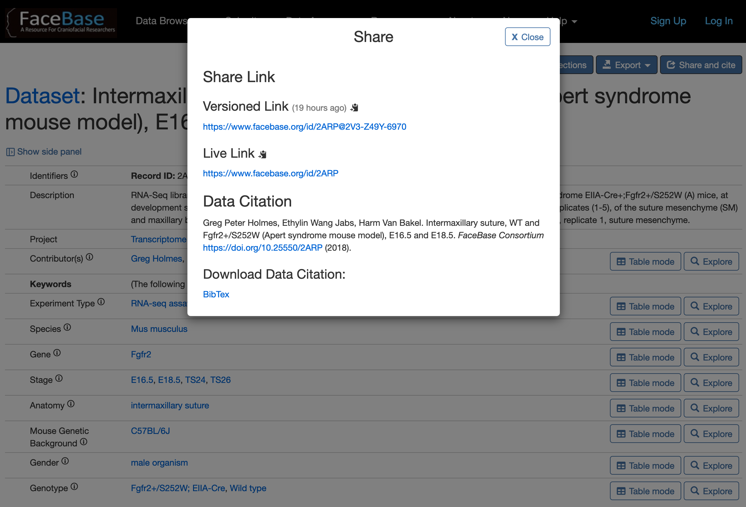
Data Citation
Persistent, actionable identifiers
Persistent actionable identifiers for all database entities
Explore any historical version of entire database
Versioned or “live”
Digital Object Identifiers
Follows leading publisher’s recommendations
Import into reference managers

Slide 20
Demonstrations of FaceBase Datasets
Demo 1: an RNA-seq dataset
Visualization Example: Genome Browser
https://doi.org/10.25550/2ARP
Demo 2: an imaging dataset
Visualization Example: Orthoslice Viewer
https://doi.org/10.25550/1-DY3G

Slide 21
Thank You
Co-PIs: Carl Kesselman; Yang Chai
Core Team: Rob Schuler (CS & Technical); Bridget Samuels (Biocuration); Alejandro Bugacov (Data science); Cris Williams (Communications); Joe Hacia (Bioinformatics); Thach Vu Ho (Data curation)
Website: www.facebase.org
Sponsor: NIH / NIDCR (U01DE028729)
Multi-Disciplined Partnership

